Slide 1

Final Presentation
Spring 2017
MyVIPCity 1.0
Team Members: Angel Paredes, Darshana Sebastian
Product Owner: Ali Aliabadi, Arash Shivazad, Hamid-reza Nazemi
Instructors: Masoud Sadjadi, Mohsen Taheri
School of Computing and Information Sciences Florida International University

Slide 2
Project Definition
MyVIPCity 1.0 is a web portal that keeps a portfolio of high end restaurants and a corresponding list of VIP Hosts. Each restaurant and VIP Host can have a profile page that can be updated with basic information and with social posts like videos, images, and comments.
Visitors can easily find and search for restaurants, navigate through their social posts, and submit attending requests.

Slide 3
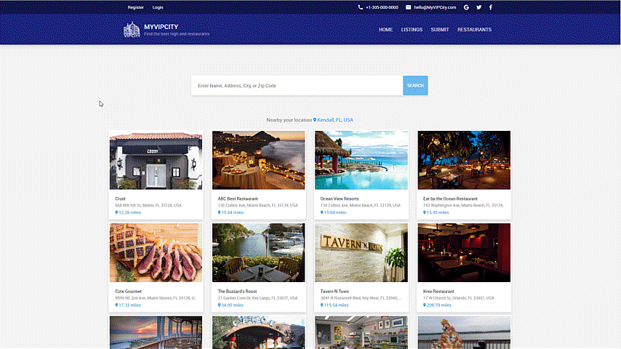
Screenshots – Home Page

Slide 4

Screenshots – Restaurant Profile

Slide 5
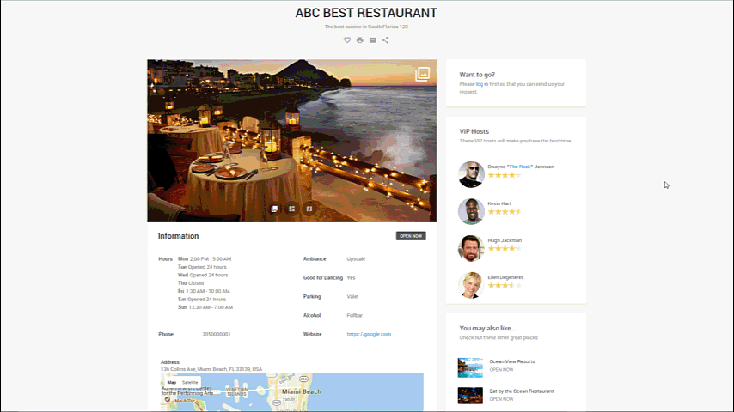
Screenshots – VIP Host Profile

Slide 6
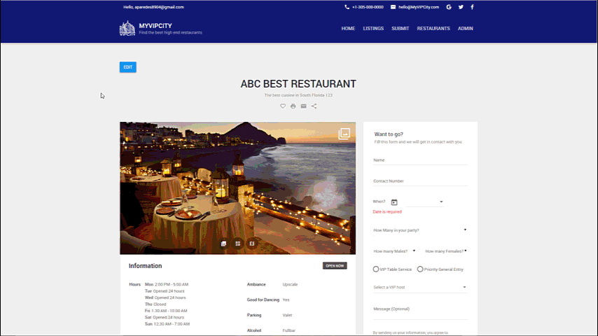
Screenshots – Restaurant Admin

Slide 7
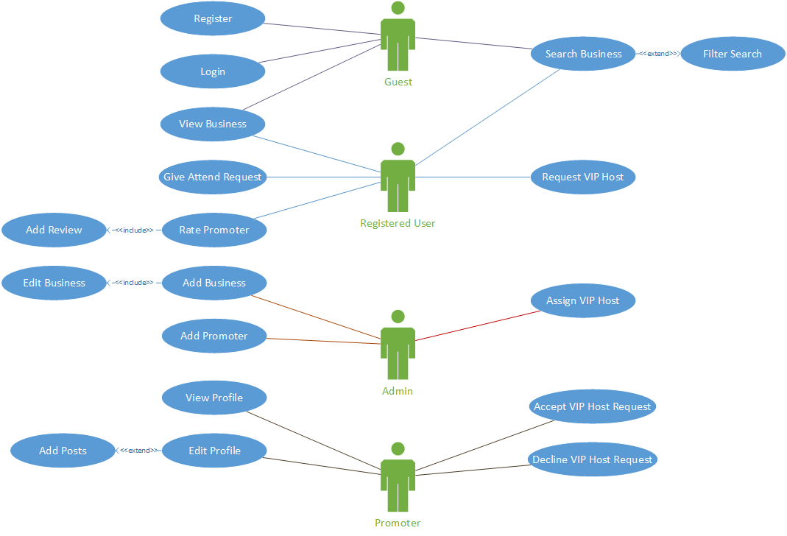
Requirements: Use Cases

Slide 8


System Design: Architecture
APPLICATION LAYER
SPA: HTML5, AngularJS
DATA TRANSFER OBJECTS
SERVICES LAYER
BUSINESS ENTITIES DTOs, …
REST SERVICES
BUSINESS LOGIC LAYER
EMAIL SERVICES
BUSINESS ENTITIES
BUSINESS ENTITIES MANAGERS
BUSINESS RULES
DATA LAYER
DATA ACCESS: DbContext (Entity Framework)
SQL Server Db

Slide 9
System Design: Deployment

Slide 10
Minimal Class Diagram

Slide 11
User Story #1
User Story #127 Create basic template/layout for the site
Define a common template for the site with a header and footer. The look and feel of the application should look all the same.
Acceptance Criteria
Have a header with Menus for all the features of the site
Have a footer showing the name of the site, current year and links to About Us, Terms & Conditions and Privacy Policy (the corresponding pages will be added in other US.

Slide 12
User Story #2
User Story #118 Create mechanism to login in the site
As a user, I would like to login into the website so that I can use the features that require authentication.
Acceptance Criteria (Summary – Details in Project Document)
User must be able to login using either a previously created account, a Gmail account or a Facebook account.
User must be able to reset a password.

Slide 13
User Story #3
User Story #117 User registration mechanism
As a user, I would like to create an account and be able to log in using that account.
Acceptance Criteria (Summary – Details in Project Document)
User must be able to fill and submit a registration form, confirm his/her email and then be able to log in.

Slide 14
User Story #4
User Story #122 An administrator user can add a new business (restaurant)
As an administrator user, I would like to be able to add a new business with all its information so that users can see it.
Acceptance Criteria (Summary – Details in Project Document)
An admin user is able to add a new business.
Provide a name, address, pictures, description, amenities, etc.
The new business can be persisted in the system.

Slide 15
User Story #5
User Story #135 An administrator user can edit an existing business (restaurant)
As an administrator user, I would like to be able to edit an existing business.
Acceptance Criteria (Summary – Details in Project Document)
An admin user is able to modify any information stored for a particular business. i.e change address, change order of pictures, etc.

Slide 16
User Story #6
User Story #136 Business (Restaurant) profile page.
As a regular user I would like to see and not be able to edit the profile page of a particular restaurant.
Acceptance Criteria (Summary – Details in Project Document)
Users can visit the profile page of an existing restaurant and see all the information associated to it. i.e Pictures, address, VIP Hosts, etc.

Slide 17
User Story #7
User Story #120 Admin users can manage the VIP Hosts of a business (restaurant).
As an admin user, I would like to be able to add and delete VIP hosts to a particular restaurant.
Acceptance Criteria (Summary – Details in Project Document)
Admin can invite VIP Hosts (provide name and email)
Admin can remove already accepted invitations.
Admin can remove pending invitations.

Slide 18
User Story #8
User Story #121 VIP Hosts can accept an invitation and join a particular business as a new VIP Hosts.
As a promoter (VIP Host) user, I would like to receive and accept invitation to join a business as a VIP Host.
Acceptance Criteria (Summary – Details in Project Document)
User can receive an invitation sent by an admin to join a business as a VIP host.
User can accept an invitation and become a VIP Host(new role).
VIP Host user can manage the new promoter profile created for the business he/she was invited from.
VIP Host user can keep many promoter profiles from different businesses.

Slide 19
User Story #9
User Story #125 An administrator con keep a social feed of a business (restaurant)
As an admin user I would like to keep a social feed for a business and be able to add comments, videos, and pictures so that users can see it.
Acceptance Criteria (Summary – Details in Project Document)
Admin users can post comments, pictures, and videos for a specific business.
Posts can be seen by all users.

Slide 20
User Story #10
User Story #126 A VIP Host con keep a social feed in all of its profiles
As VIP Host user I would like to keep a social feed for any of my profiles and be able to add comments, videos, and pictures so that users can see it.
Acceptance Criteria (Summary – Details in Project Document)
VIP Host user can post comments, pictures, and videos for any of its profiles.
Posts can be seen by all users.

Slide 21
User Story #11
User Story #150 Users can add a review for a specific VIP Host profile
As an user, I would like to add a review for a promoter profile.
Acceptance Criteria (Summary – Details in Project Document)
Users can visit a promoter profile, go to the Reviews tab and add a new review.
Review consists of 1-5 Stars and a comment.
Promoter rating average is updated with new review.
Comments must be validated to forbid the use of obscene/inappropriate words.

Slide 22
User Story #12
User Story #123 Search and filtering of businesses (restaurants)
As an user, I would like to be able to search for restaurants by different criteria.
Acceptance Criteria (Summary – Details in Project Document)
Restaurants will be shown to the user sorted by distance to the user’s location.
User can enter a search criteria like, address, city, state, zip code, name of the restaurant.

Slide 23
User Story #13
User Story #157 User can submit an attending request for a restaurant.
As an user, I would like to submit an attending request to a restaurant and get a response specifying if the request is accepted/declined.
Acceptance Criteria (Summary – Details in Project Document)
On the profile page of a specific restaurant, an user can fill a form with the information of date, and the number of people that want to go to the restaurant. Also a VIP host can be specified.

Slide 24
Test Suites and Test Cases
Sunny Day
Purpose | Register user into the system
Precondition | User have access to the application
Input | Email Address Password Confirm Password
Excepted Results | User is registered with and a confirmation email is sent to the provided email address. User confirms the email address User able to login
Actual Results | Same as expected
Test Result | Pass

Slide 25
Test Suites and Test Cases
Sunny Day
Purpose | Add a review to a VIP Host
Precondition | User have access to the application
Input | User is logged in VIP Host profile opened REVIEWS tab selected. Current Average Rating = 4 #Reviews = 1.
Excepted Results | New average rating = 4.5 #Reviews increased by one
Actual Results | Average rating = 4.5 #Reviews = 2
Test Result | Pass

Slide 26
Summary
MyVIPCity 1.0 is a single page application that keeps a portfolio of high end restaurants (businesses). Each restaurant has a profile page where admins can modify the information and keep a social feed where they can post comments, pictures and videos. Restaurants have a list of VIP Hosts and each host also has a profile where they can also post comments, images and videos.
MyVIPCity 1.0 allows users to easily search for restaurants, navigate through the profile page of restaurants and VIP Hosts, and submit attending requests for restaurants.

Slide 27













Questions
Angel Paredes: apare033@fiu.edu
Darshana Sebastian: dseba006@fiu.edu

